Slide 1
Design And Analysis of Algorithms Isomorphism of Organic Compounds
By
SAI SHANKAR (2010030054)
PS YESHWANTH (2010030122)
SRIKAR KANCHE (2010030474)
SAI MANASWI (2010030325)
Under the guidance of
DR .DEEPTHI KALAVALA

Slide 2
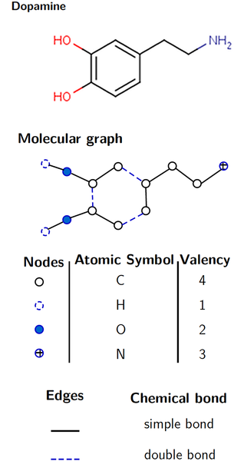
PROBLEM STATEMENT
In Chemical bond structure, Structure of chemical bond is very different than normal graph hence it becomes very tedious job to apply graph isomorphism algorithms for such kinds of structure.
Here also first convert bond structure in relevant graph format then go for graph isomorphism.
In Chemical bond structure, each node has a unique identification number. If in case, it is changed in that case it is assumed that chemical structure is changed.

Slide 3
Proposed Algorithm Design Technique
The proposed algorithm for isomorphism is VF2 algorithm.
The Graph Matcher are responsible for matching graphs in a predetermined manner. This usually means a check for an isomorphism, though other checks are also possible.
The VF2 Algorithm is a matching graphs or directed graphs in a predetermined manner. Hence Used for Checking isomorphism in two chemical compounds
It Returns Boolean if given two graphs are isomorphic or not.

Slide 4
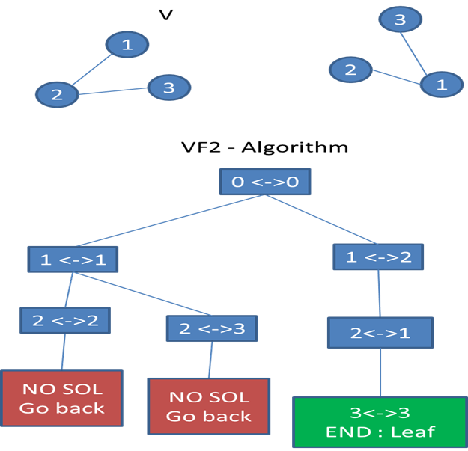
VF2 Algorithm Steps:
step 1 : Match empty V with empty V' : it always works
step 2 : I can match 1V with 1V',2V' or 3V’ Match 1V with 1V' : it always works
step 3 : We can match 2V with 2V' or 3V’ Match 2V with 2V' : it works because {1V 2V} and {1V' 2V} are isomorphic
step 4 : Match 3V with a node in 3V’ It cannot be possible as there is no edge that connects both Nodes. So, I go back to step 2
step 5: Repeat it Unit all Nodes are pushed into Set.

Slide 5
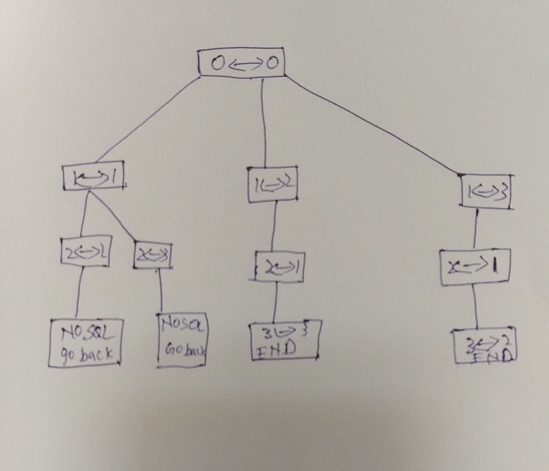
State space tree

Slide 6
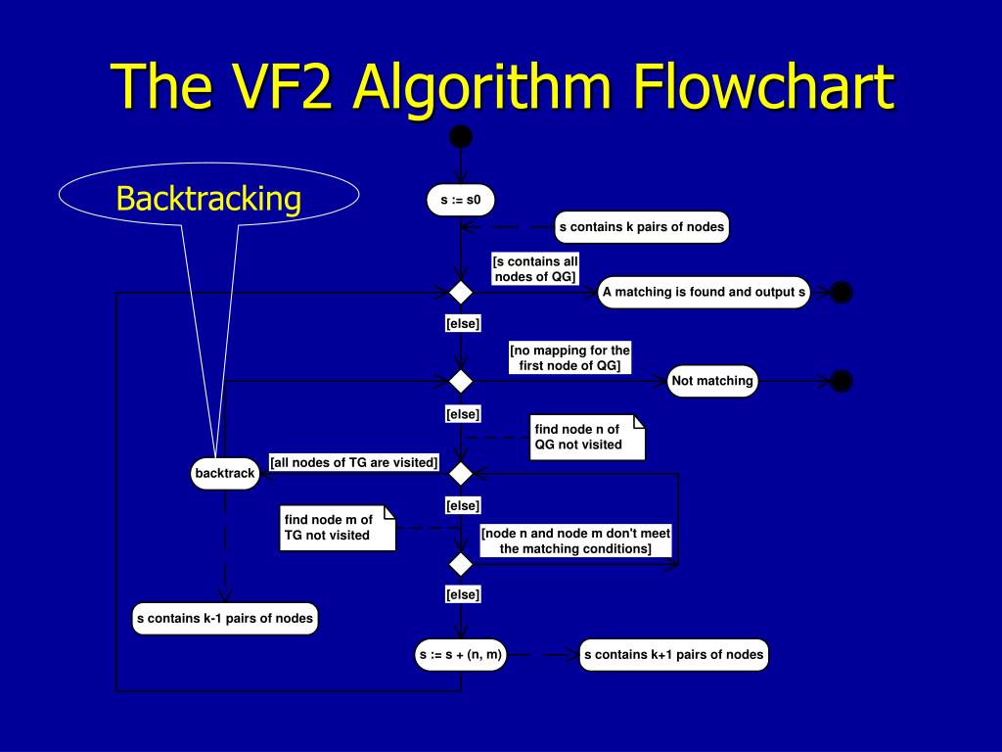
Flow chart of the proposed solution :

Slide 7
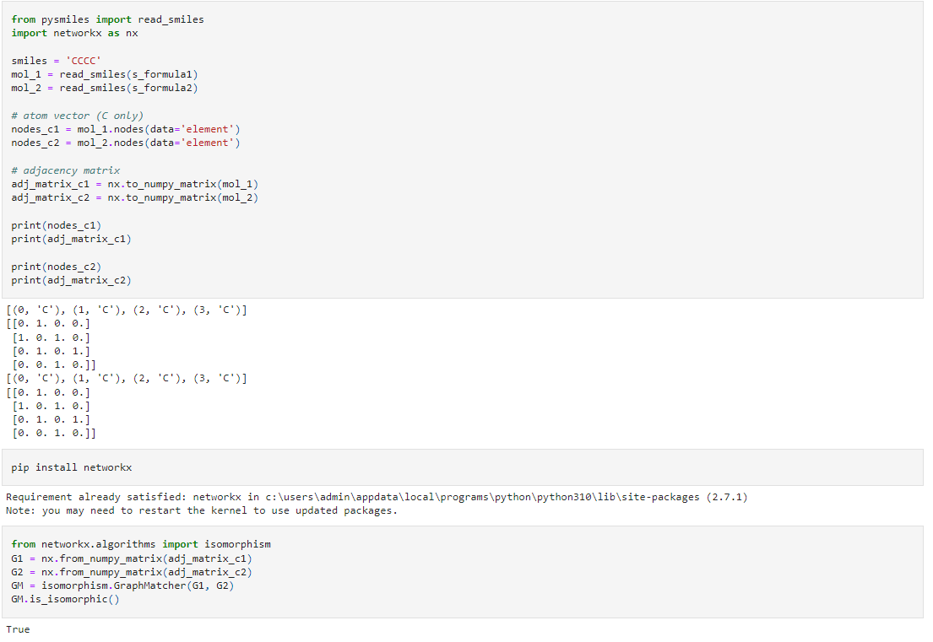
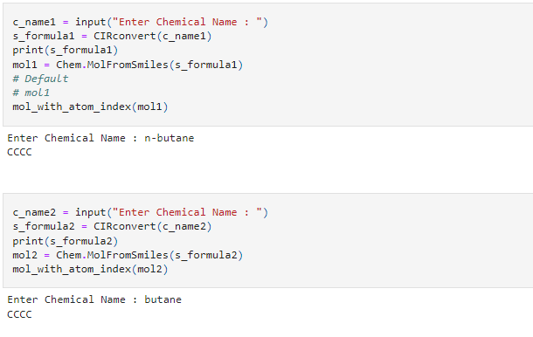
Numeric example of the algorithm :
OUTPUT
INPUT

Slide 8
Coding status and testing:
https://colab.research.google.com/drive/1oH45TobOPOwMQJADPatmPznsRbAY19FG?authuser=1

Slide 9
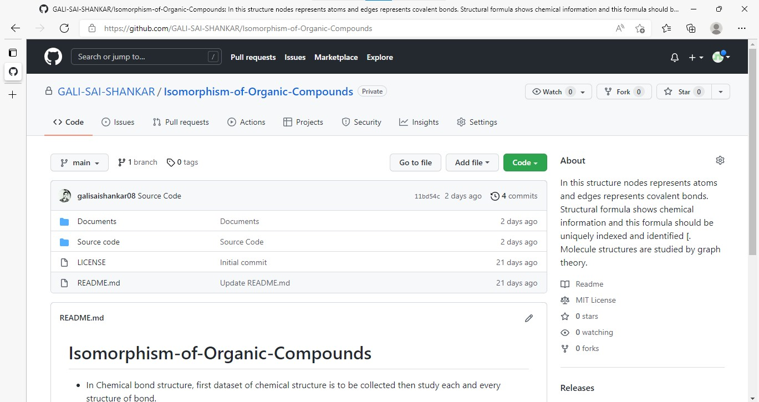
GitHub setup
https://github.com/GALI-SAI-SHANKAR/Isomorphism-of-Organic-Compounds

Slide 10
Division of work among the group members
SAI SHANKAR 2010030054 (Smiles conversion)
PS YESHWANTH 2010030122 (Chemical structure)
SRIKAR KANCHE 2010030474 (converting to graph)
SAI MANASWI 2010030325 (graph Isomorphism )

Slide 11


